Slide 1
Watersheds with possible point source concerns
Oct 2015

Slide 2
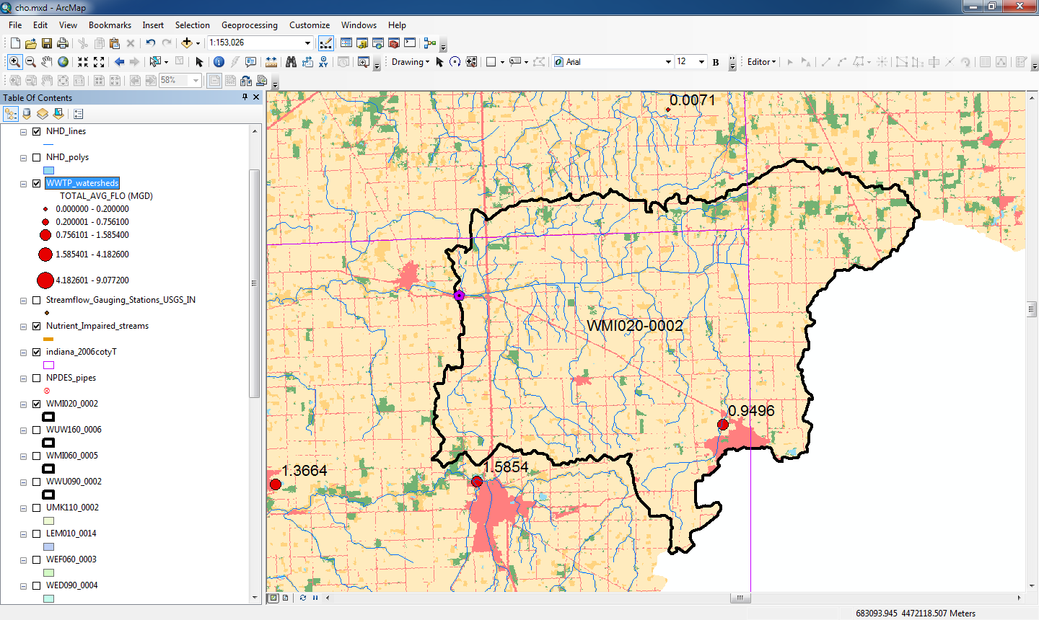
WMI020-0002
1 POTW yield .9 MCGD in this watershed

Slide 3
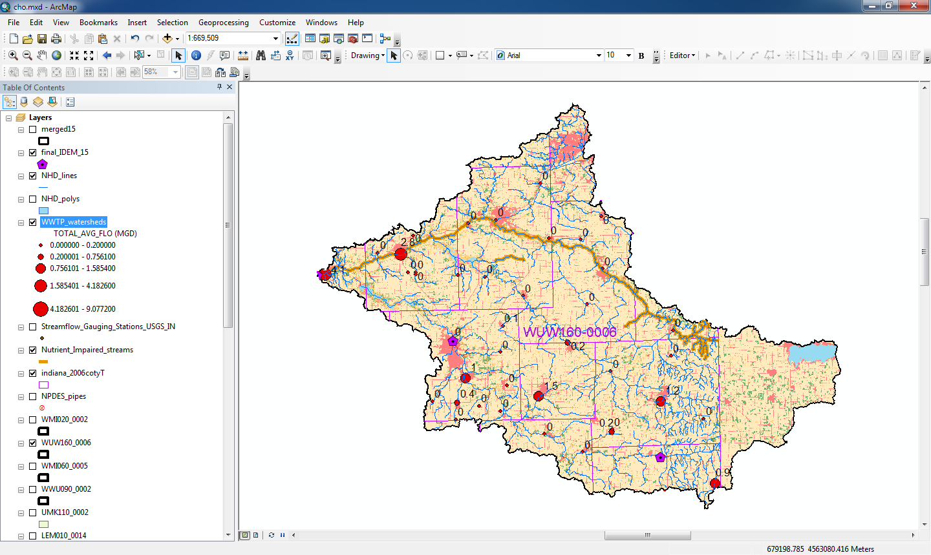
WUW160-0006
40 WWTP yield 12.4 MCGD in this watershed

Slide 4
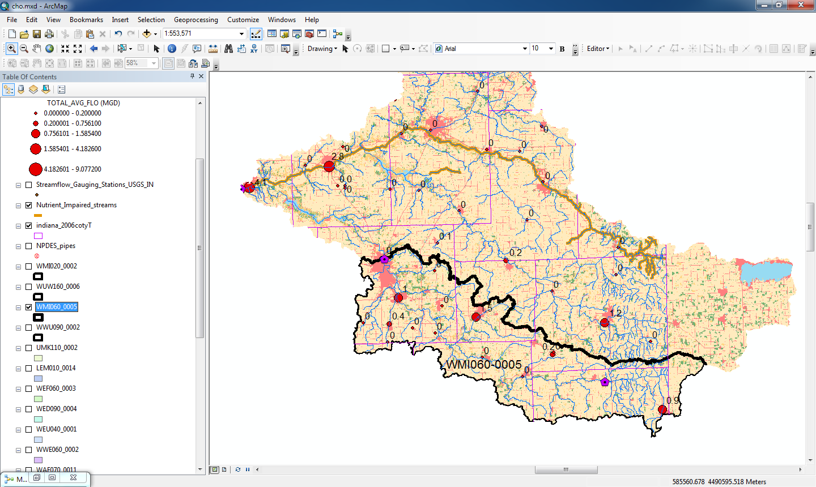
WMI 060-0005
14 POTW yield 4.0 MCGD in this watershed

Slide 5
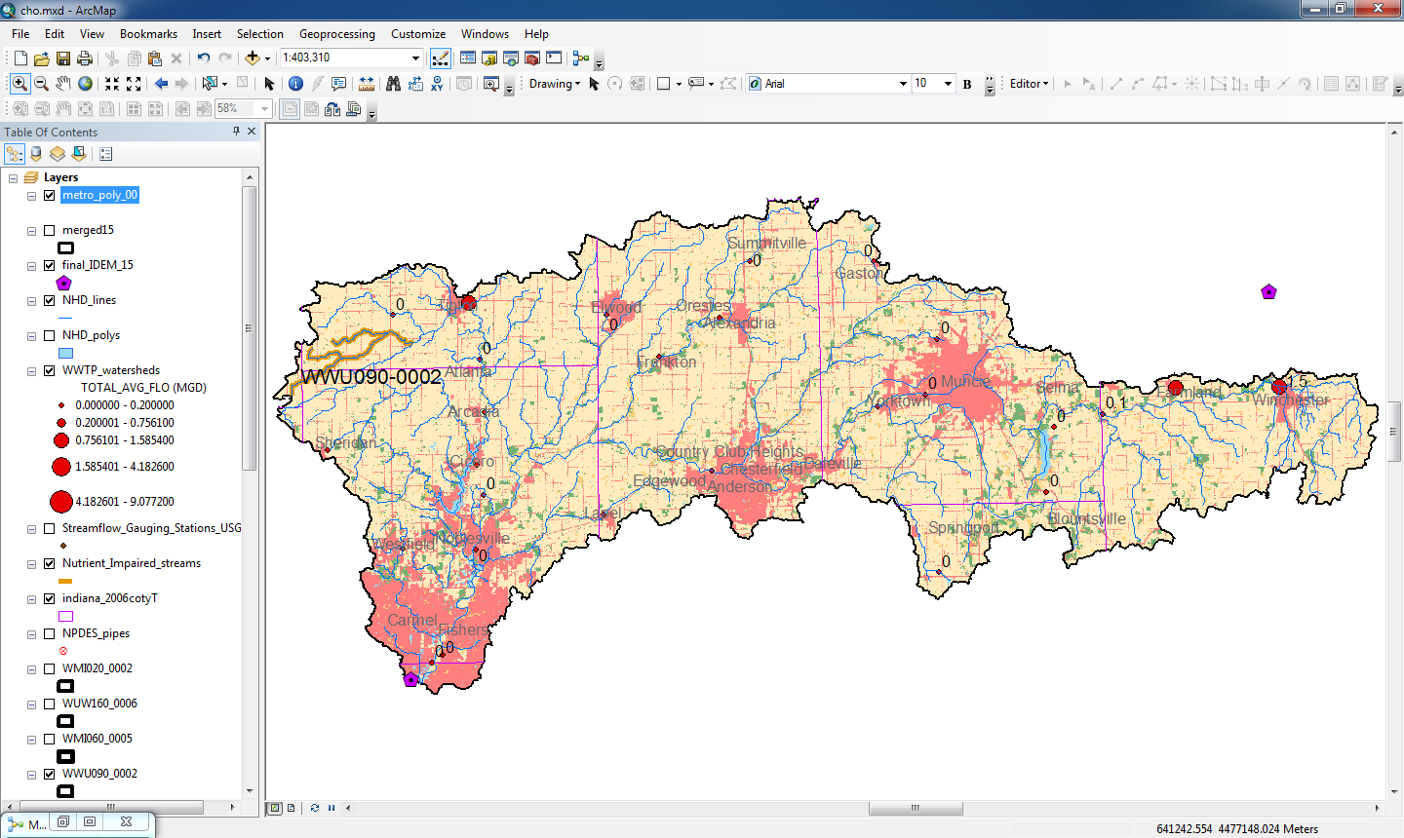
WWU 090-0002
27 POTW yield 4.2 MCGD in this watershed, But we are missing totals for
Muncie, Anderson, Carmel, Fishers, Noblesville

